Slide 1






SSB – Capacity Planning for CloudHub Project (Mulesoft)
April 16, 2021
Working Draft
Notes:
SSB-MuleSoft project is part of the overall Digital Program that encompasses 3 projects: MuleSoft, Backbase, and the Data under ‘one program’ governance structure. Further details will be posted soon

Slide 2
Introductions to Cloudhub and features
It is A cloud-based integration platform as a service (iPaaS) that enables developers to integrate and orchestrate applications and services.
No need to install or manage middleware or hardware infrastructure.
CloudHub as itself and the Mule applications are deployed and executed under an AWS infrastructure. Specifically, each deployed application is running under an EC2 instance with Linux and a Mule runtime within a JVM.
Each worker has a specific amount of capacity to process data. Select the size of your workers when configuring an application.
Worker Name | Worker/Heap Memory | EC2 Instance Name
0.1 vCores | 500 MB | t2.micro
0.2 vCores | 1 GB | t2.small
1 vCore | 1.5 GB | m3.medium
2 vCore | 3.5 GB | m3.large
4 vCore | 7.5 GB | m3.xlarge
8 vCore | 15 GB | m3.2xlarge
16 vCore | 32 GB | m4.4xlarge

Slide 3
Introductions to Cloudhub and features
Each instance per worker work is more complex than it may seem.
CloudHub workers also execute CloudHub system services on the OS and Mule runtime, which are required for the platform capabilities provided by CloudHub, such as:
Monitoring of Mule applications in terms of CPU, memory, usage, number of messages and errors, etc. which allow Anypoint Platform to provide analytics and alerts based on these metrics.
Auto-restarting failed CloudHub workers (including a failed Mule runtime on an otherwise functional EC2 instance).
Load-balancing only to healthy CloudHub workers.
Provisioning of new CloudHub workers to increase/reduce capacity.
DNS entries for the CloudHub workers and CloudHub Load Balancer.
Persistence, using Object Stores, of message payloads or other data across the CloudHub workers of a Mule application.

Slide 4
CloudHub vCore and Sizes
Worker Name | Worker/Heap Memory | Worker Storage | EC2 Instance Name
0.1 vCores | 500 MB | 8GB | t2.micro
0.2 vCores | 1 GB | 8GB | t2.small
1 vCore | 1.5 GB | 12GB | m3.medium
2 vCore | 3.5 GB | 40GB | m3.large
4 vCore | 7.5 GB | 88GB | m3.xlarge
8 vCore | 15 GB | 168GB | m3.2xlarge
16 vCore | 32 GB | 328GB | m4.4xlarge

Slide 5
Capacity/Core sizing
There are many factors which can decide on your application capacity of processing transaction.
What type of integration you are running.
No of request.
Payload sizes
Concurrent users accessing the api.
Complexity of your api. (simple/medium/high).
Dataweave mapping complexity
Considering 0.1vCore for a single application deployment
Environments | vCore | application
Production | 6 | 60
Non Production | 12 | 120

Slide 6
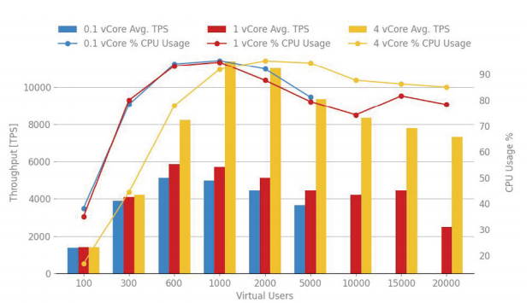
HTTP Get with 1Kb payload for 0.1, 1, 4 vCores – average throughput and % of CPU usage

Slide 7

Thank you!
PwC | Sandy Spring Bank
Confidential information for the sole benefit and use of PwC’s client

Slide 8
Project Objectives - High Level
Mulesoft platform provides the foundation for hosting APIs and acts as a middleware layer
The Mulesoft C4E (center for enablement) provides common framework, patterns, best practices
API as a product enables the bank to interact with other technologies, opens the door for future of banking innovations and help accelerate digital transformation
Provide governance, routing, orchestration, transformation, and persona-based management capabilities
Design, build and deploy APIs on an Enterprise Integration Platform, with the initial goal of supporting the bank’s digital initiative of launching a new Consumer / Retail servicing platform
Create an abstraction layer on top of multiple backend systems to reduce dependencies and improve reusability
PwC | Sandy Spring Bank
8

